Slide 1
OBE Implementation
SUBMITTED BY:
Geetesh Kotturu AP22110010062
Gali Lakshmi Pujitha AP22110010206
Sai Charitha Yella AP22110010213
Satwick Gamidi AP22110010214
Geethika Gangireddy AP22110010259

Slide 2
Introduction to Project
Our University (herewith considered as SRM-AP) is going to implement OBE(Outcome Based Education) in their university and you
are assigned in the project to develop a CURD(Create, Update, Retrieve and Delete) windows and mobile application using
JAVA programming and Android studio for the same.
Project Modules:
Various Modules available in the project are
1.Blooms Level setting
2.Program Level Objective Setting
3.University
4.Schools
5.Department
6.Programs
7.Courses
8.Course objective setting
9.Course Outcome Setting
10.Course Articulation matrix Setting
11.Course Utilization Setting
12.Course Reference Setting.

Slide 3
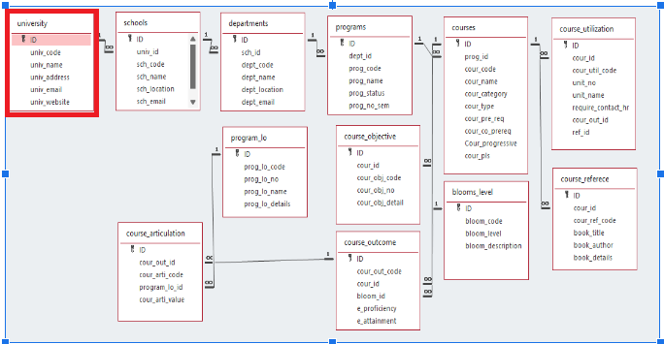
Architecture Diagram

Slide 4
Module Description : University Setting
This module is designed to perform Create, Update, Retrieve, and Delete (CRUD) operations for managing university information. It stores all university-related data in an SQLite database and provides a user-friendly interface using Java Swing. The module serves as a key component of the Outcome Based Education (OBE) system by ensuring structured data handling and easy integration with other modules like Schools, Departments, and Courses.

Slide 5
University Setting:Field/table details
Field Name | Data type
id | integer
univ_code | String
univ_name | String
univ_address | String
univ_email | String
univ_website | String

Slide 6
University Setting:Programming Details
File name:TeamA_University.java
Function/method name
Create: university_TeamA_create
Update: university_TeamA_update
Retrieve: university_TeamA_retrieve
Delete: university_TeamA_delete

Slide 7
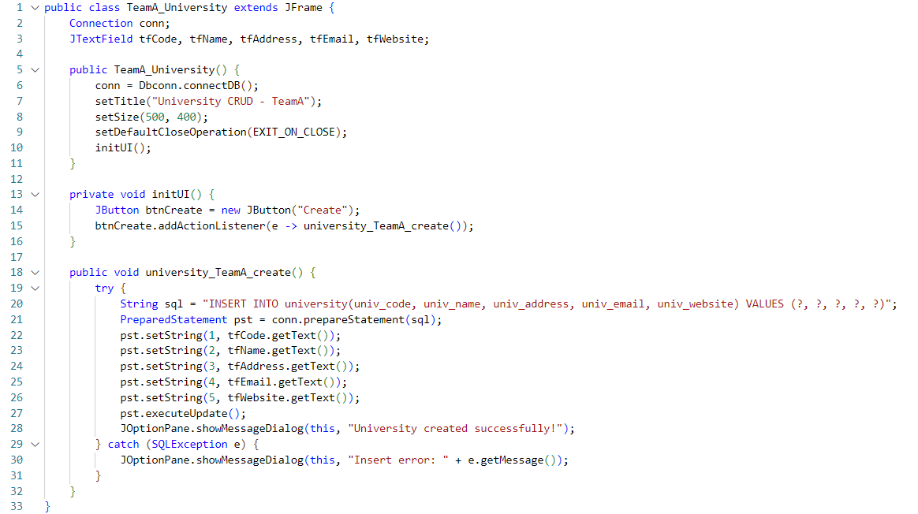
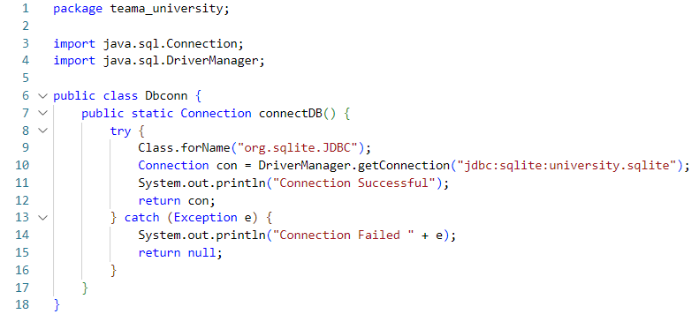
Sample Source Code
TeamA_University.java Dbconn.java

Slide 8
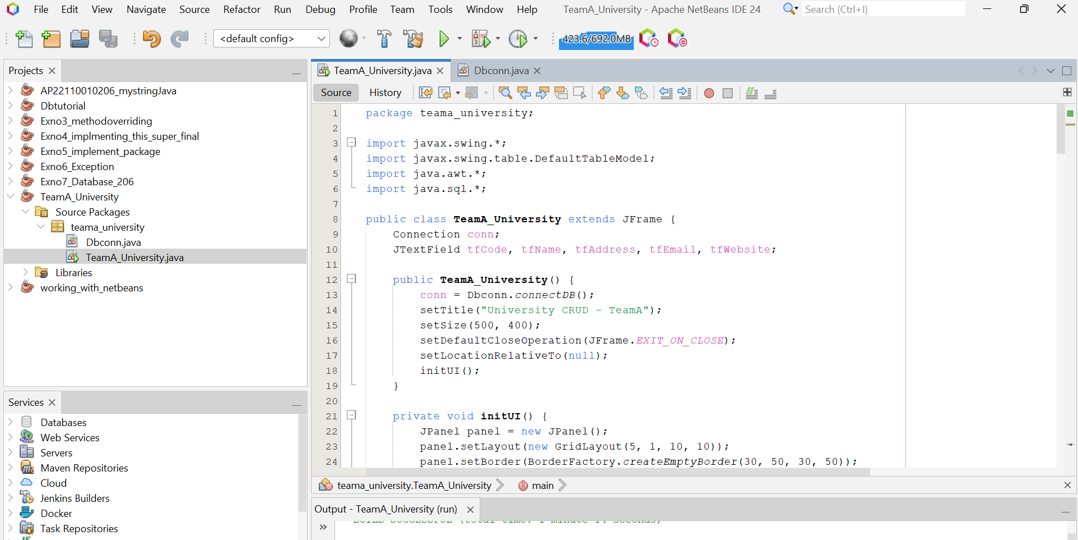
Java NetBeans Setup:

Slide 9
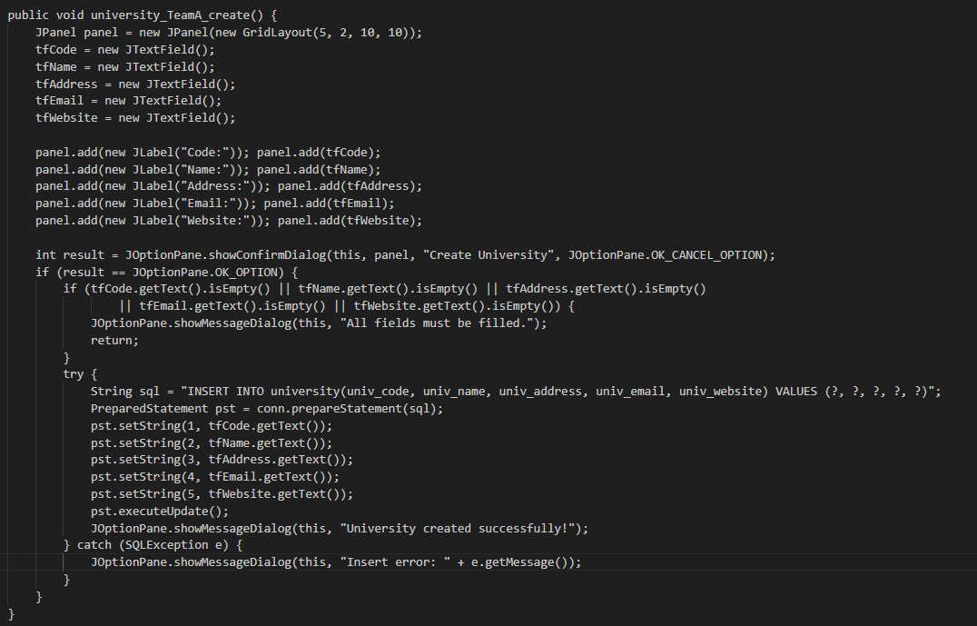
Create :

Slide 10
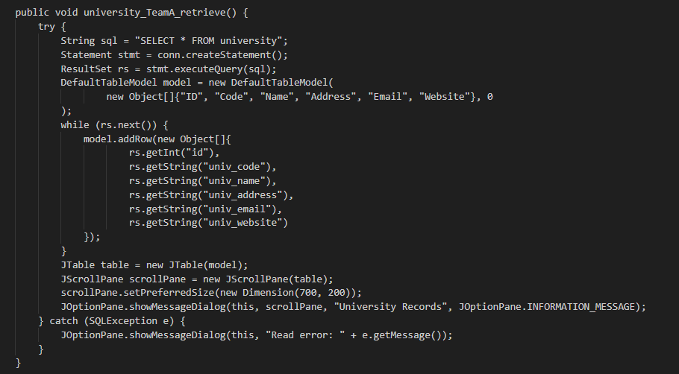
Retrieve :

Slide 11
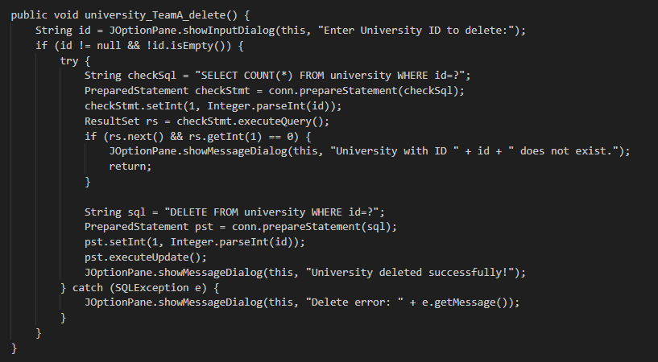
Delete :

Slide 12
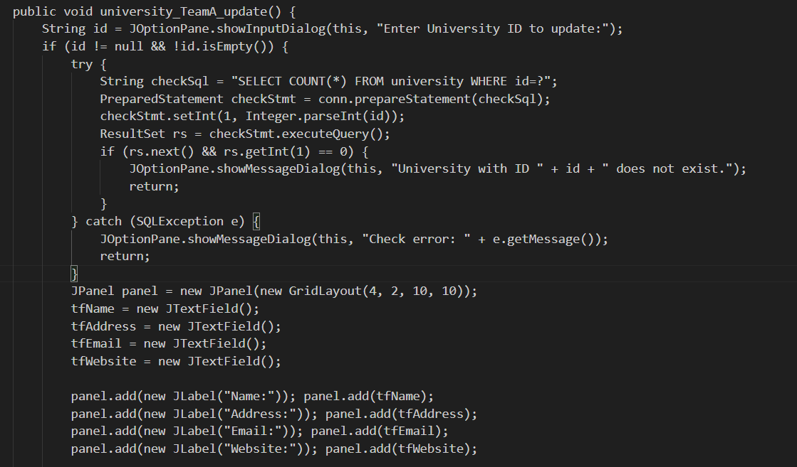
Update :

Slide 13
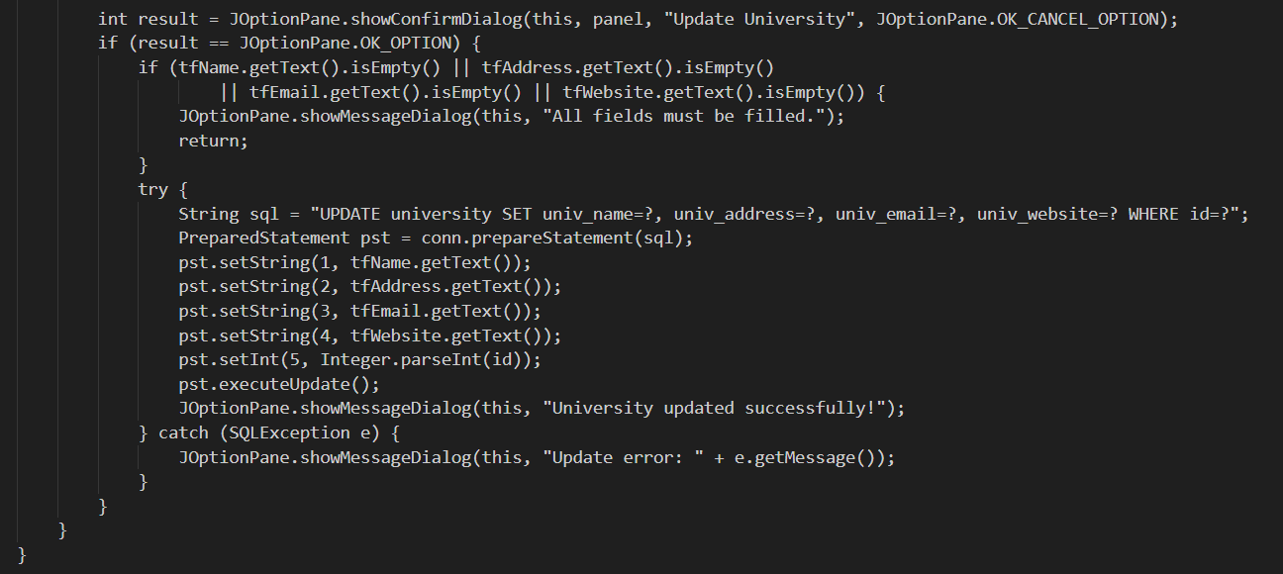

Slide 14
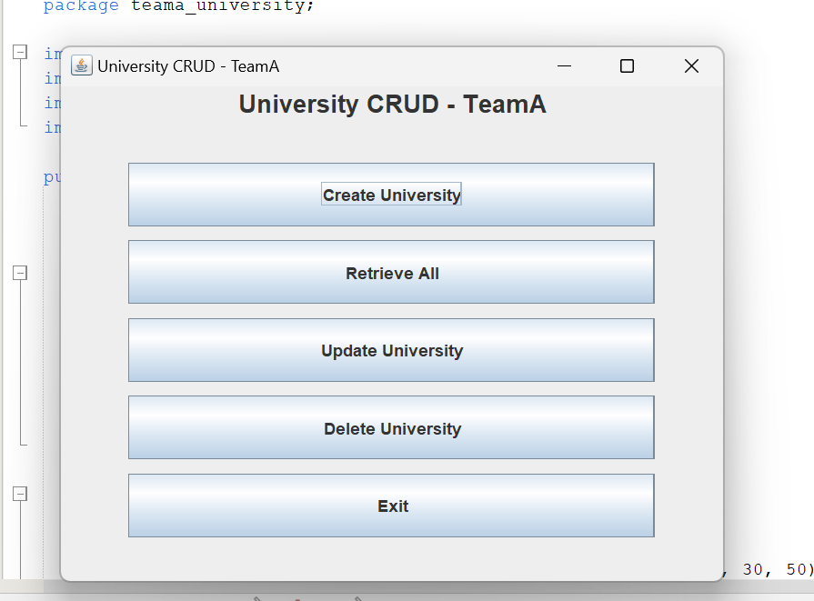
Output:

Slide 15
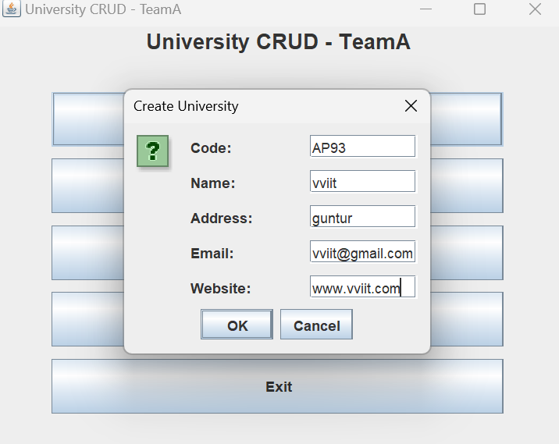
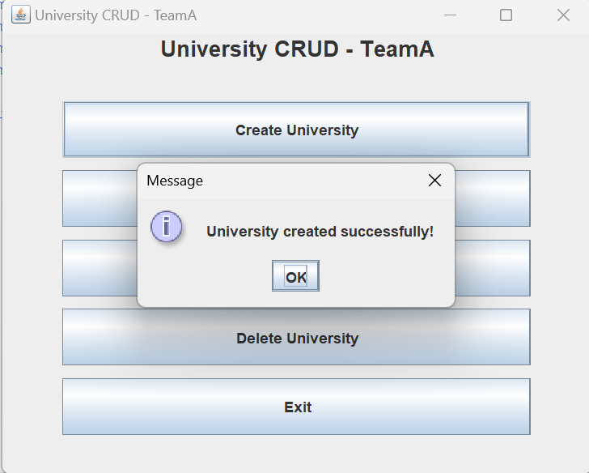
CREATE

Slide 16
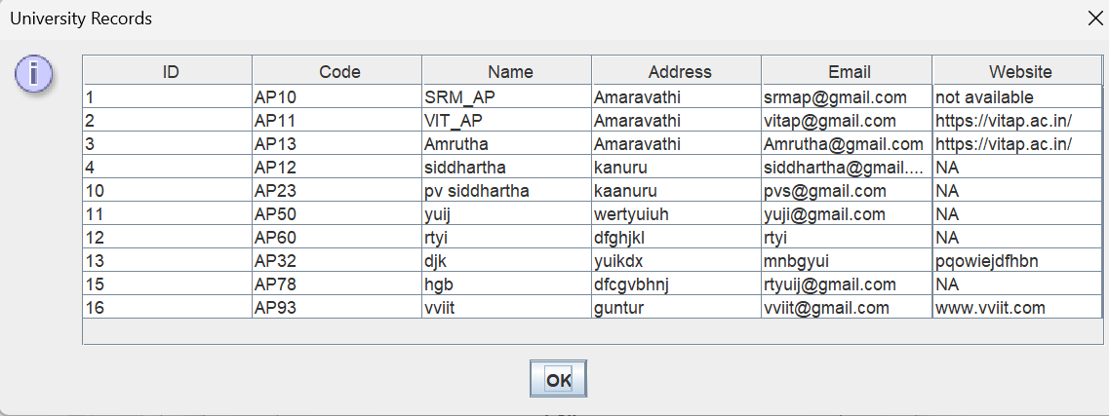
RETRIEVE

Slide 17
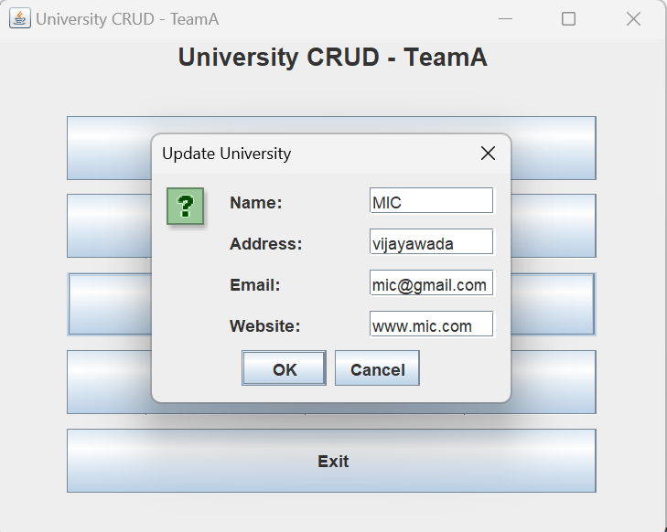
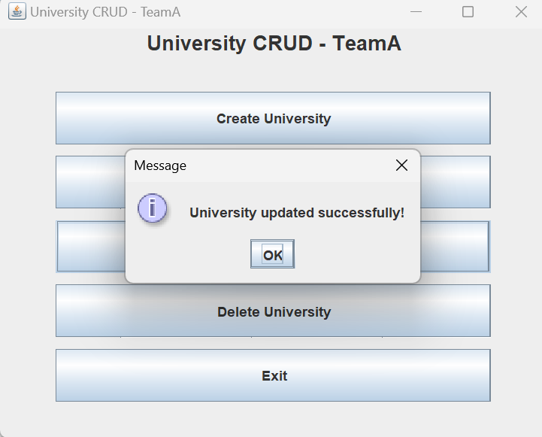
UPDATE

Slide 18
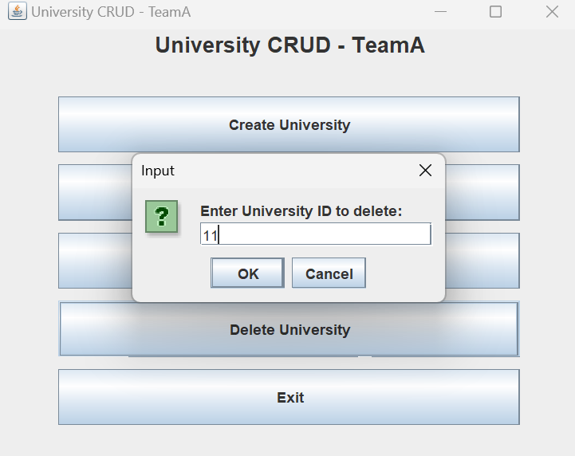
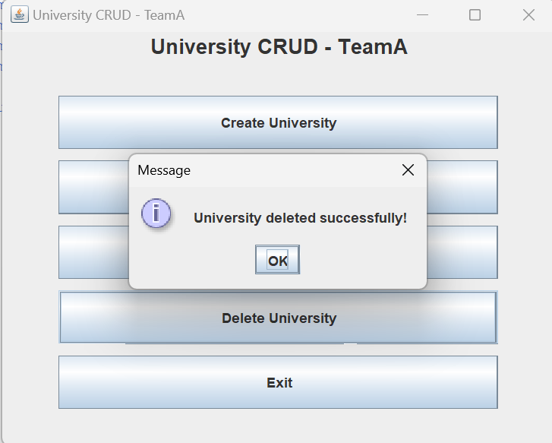
DELETE

Slide 19
Conclusion
This project involved the development of a University module as part of the Outcome Based Education (OBE) system. Built using Java and SQLite, the application supports core CRUD (Create, Read, Update, Delete) operations. A simple and intuitive interface was developed using Java Swing.
The project followed structured naming conventions and clean code practices, making it easier to maintain and scale. The University module integrates seamlessly with other OBE components such as Schools, Departments, and Courses. Overall, the module serves as a strong foundation for building a comprehensive OBE application for SRM University–AP.

Slide 20
Thank You

